Slide 1
The
Learner Control
Principle
Chapter 21: Alison Wix & Scott Copley

Slide 2
What is the Learner Control Principle?
A learning environment in which learners are able to control instruction by selecting the order of the content being delivered, along with the pace of their own progress. They may also choose how the information is displayed.

Slide 3
Learner Control Principle
The learner can:
Set the pace
Choose the sequence
Get additional support

Slide 4
Possible Benefits to Learner Control...
Allows for active processing of instruction
Increases/sustains motivation to learn
Helps to acquire self-regulatory skills
Learners adapt instruction to their preferences and needs

Slide 5
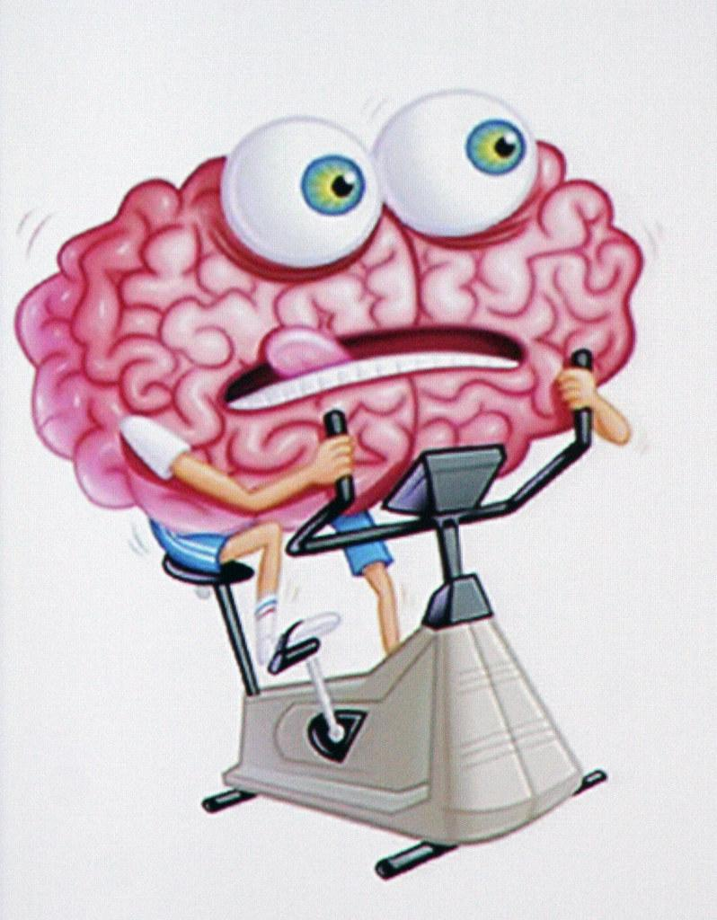
Cognitive Load Theory
Learner control increases the learners extraneous cognitive load, requiring cognitive resources that could instead be used in comprehension activities.

Slide 6
Cognitive Flexibility Theory
Network-like structures allow learners to compare and contrast topics from multiple perspectives.

Slide 7
Prior Knowledge is Essential
The role of prior knowledge cannot be understated. Those with prior knowledge will be able to navigate the information based upon their needs and preferences.
Those with limited prior knowledge will not benefit from learner control, and their learning may ultimately be harmed.

Slide 8
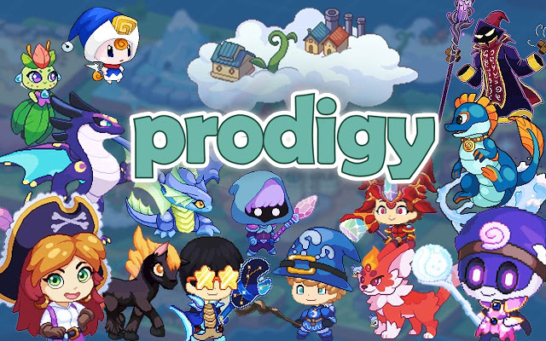
Prodigy vs. Pear Deck

Slide 9
Web-based math program for grades 1-8
“Game-like” quality
Interactive and engaging
Self-paced
Tailors math content to a child’s specific needs
Provides assessment
Provides strengths and weaknesses

Slide 10
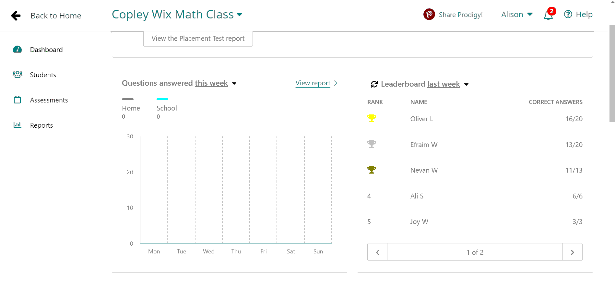
Class Data for Prodigy

Slide 11
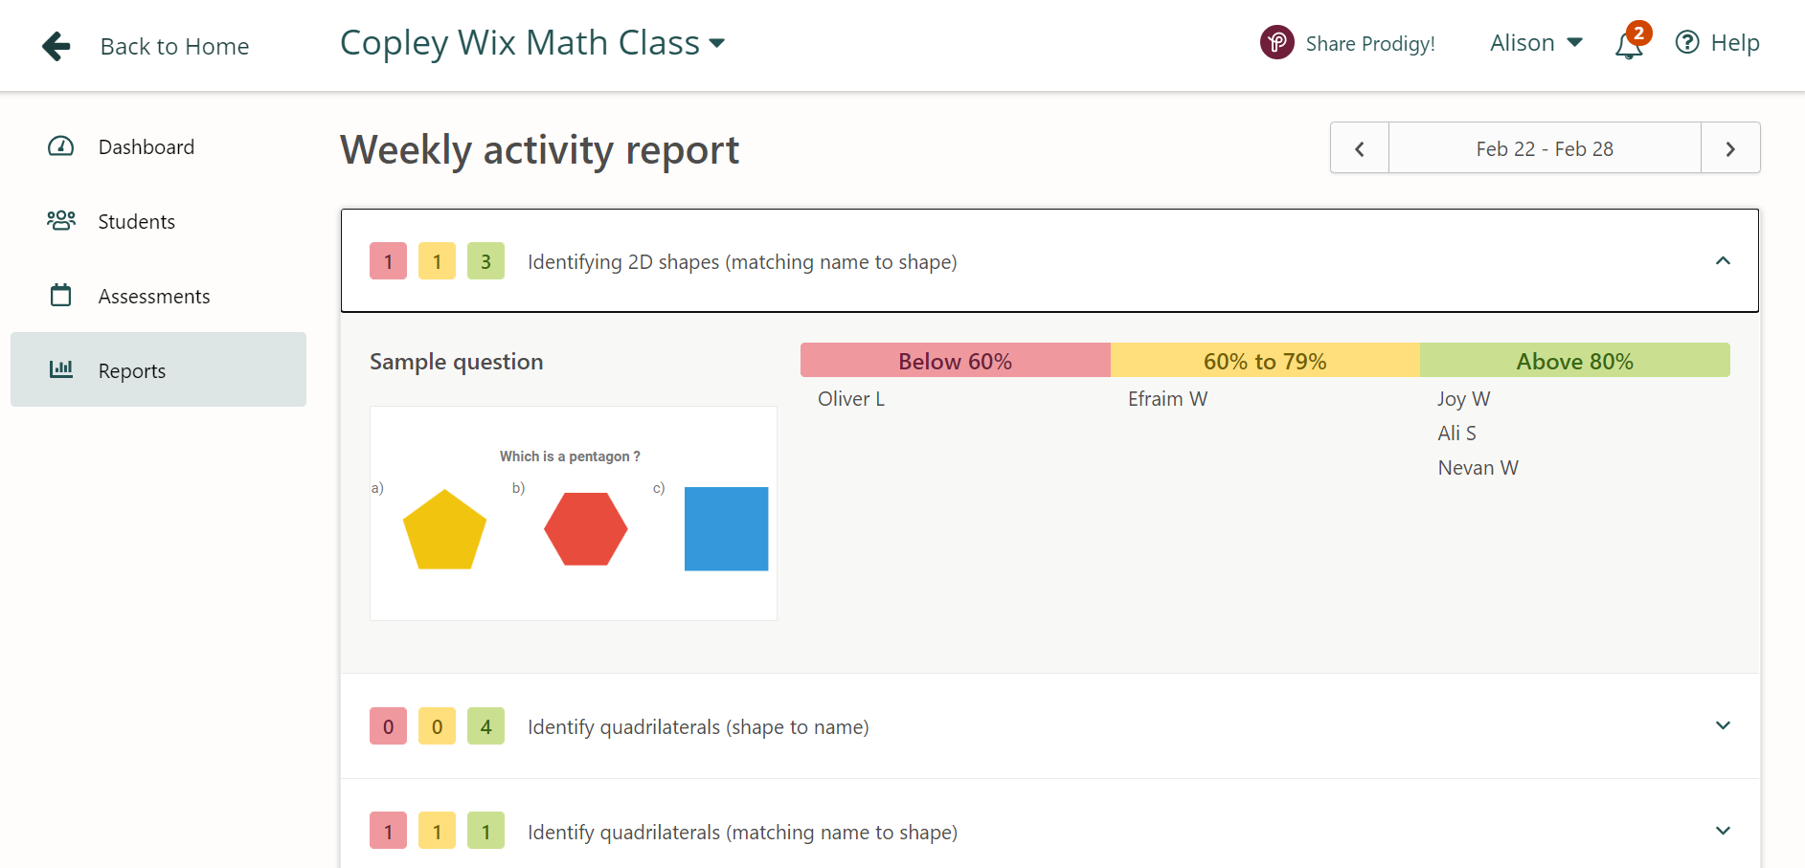

Slide 12
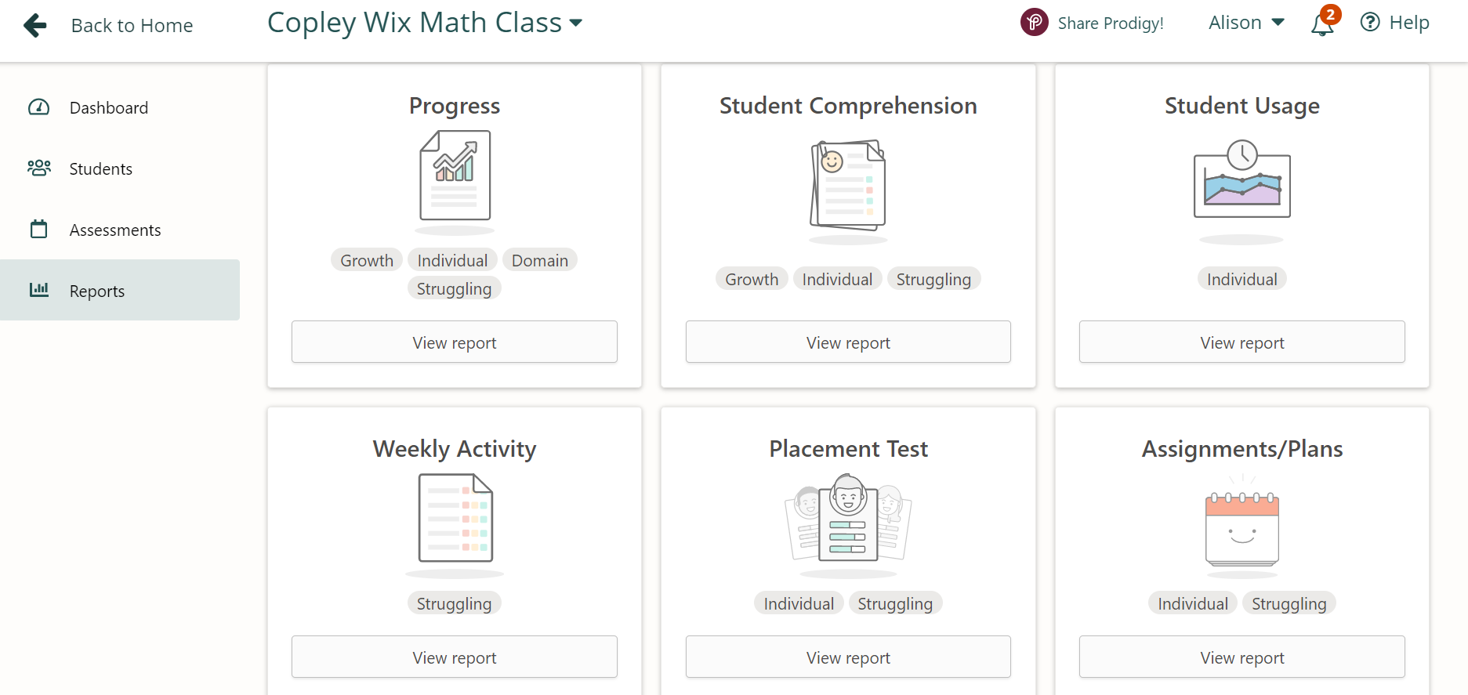

Slide 13
Pear Deck
Allows for interaction
Keeps students engaged
Can make it:
Self-paced
Self-directed
Self-sequenced
Provides formative assessments

Slide 14
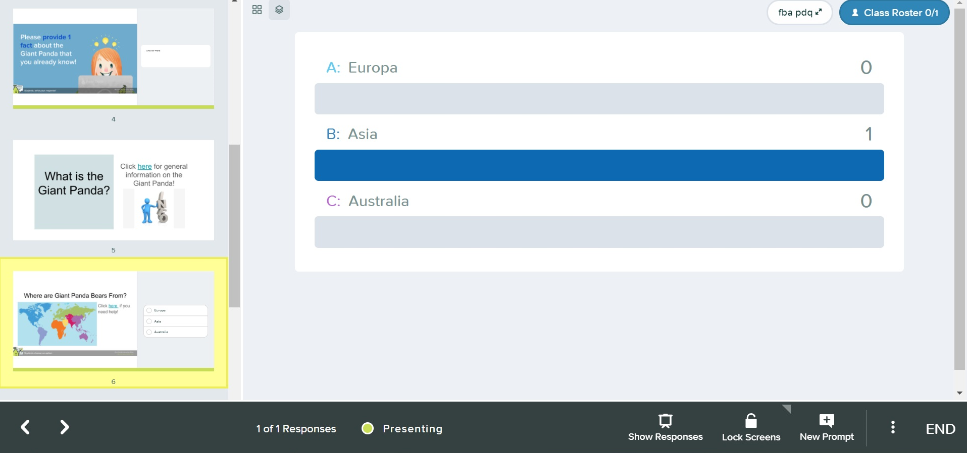
Class Data

Slide 16
Quotes From Peers
“I found the Pear Deck activity to be a great example of the learner control principle, since it gives the learner control over the instruction by allowing the student to pace, sequence, and select information.”
“I feel like the Pear Deck activity was better adapted to individual needs [in comparison to the Prodigy activity].”
“With the Prodigy game, I am a little skeptical about the levels of control the learner has...I’m not sure if the learner is really controlling what they learn.”

Slide 17
Reference
Scheiter, K. & Leibniz-Institut für Wissensmedien (2014). The Learner Control Principle in Multimedia Learning. In R.E. Mayer (Ed.), The Cambridge handbook of multimedia learning, 2nd Edition (p. 487). Cambridge University Press.

Slide 18
Thank you for Listening!
Do you have any questions?

